Slide 1

ITIL And DevOps
Chris Fulton, GTAM, Electric Cloud

Slide 2
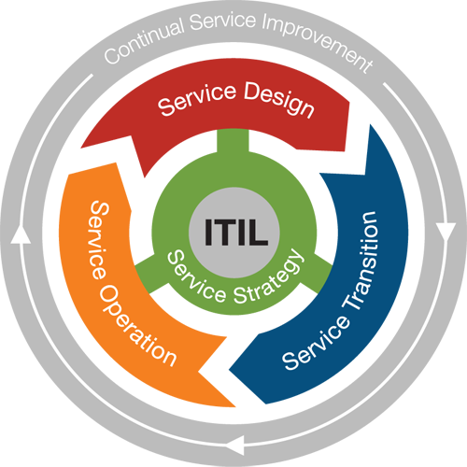
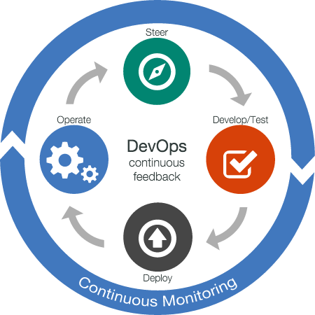

ITIL, ITSM, and DevOps
Notes:
ITIL has been around for a long time, and has helped large teams (particularly those that are heavily regulated) manage the way services are delivered in a predictable and consistent way, as a way to mitigate risk. DevOps, as we know, has a very similar goal.
http://electric-cloud.com/blog/2016/03/itil-and-devops-friend-or-foe
This talk focuses on Service now, as it is the most commonly ITSM used one in the FinServ markets.

Slide 3

How does process fit into DevOps?
Getting “stuck” in change management
How do you stop “waiting for approvals”
Should you automate certain approvals?
Notes:
How does process fit into DevOps?
You can only automate delivery so much, but if a change is stuck in “change management”, then you still do not have a continuous process
Can be a delay between approvals and delivery
How do you expedite approvals?
Automate where it makes sense

Slide 4

Getting out of waiting for approvals
Categorize changes
High / Medium / Low
Automate information
Get “humans” out of the business of creating change tickets
Auto-approve low risk changes, if no dependency
Notes:
ElectricFlow can write to Service Now information about change tickets, so that you no longer have to have a machine do it
You should provide information back to the Build System from the CR system
Automatically add to CR information about testing/build already done

Slide 5

Getting out of waiting for approvals
Automate the process from “approved” to deploying to an environment
Keep logs of everything (done for you in ElectricFlow™)

Slide 6
Practical Example

Slide 7
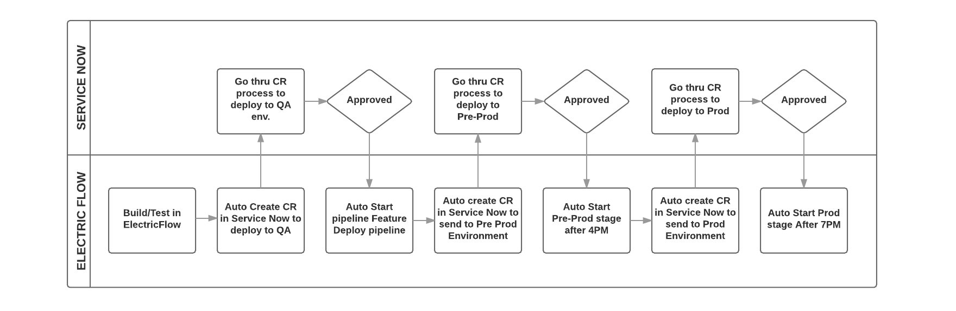
Example of DevOps and ITIL process

Slide 8
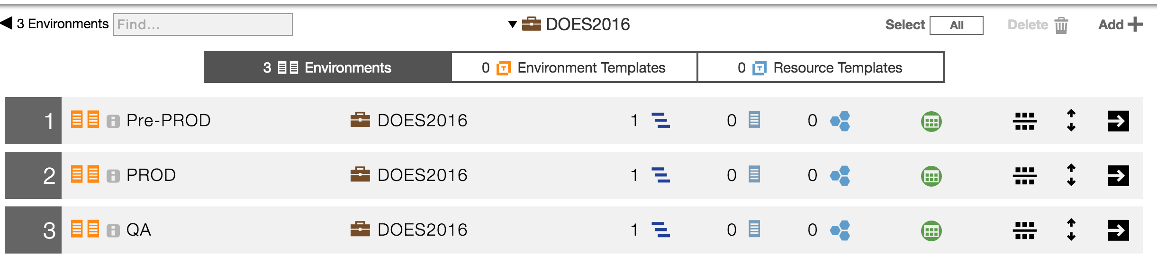
ElectricFlow™ Environment

Slide 9
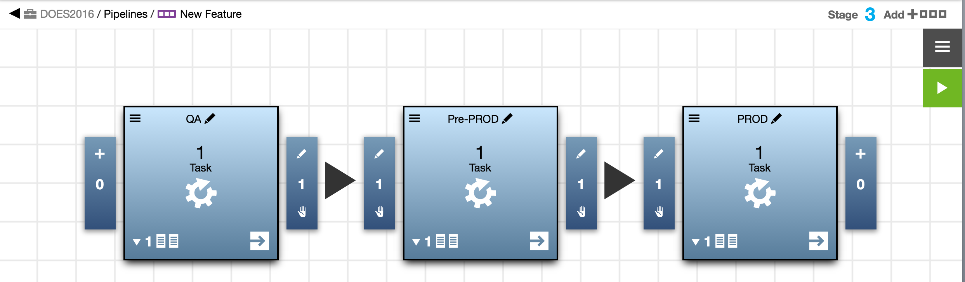
ElectricFlow™ Pipeline

Slide 10

Process Explained
Notes:
Point out how the various stages in the process correspond to the pipeline

Slide 11
ElectricFlow™ Service Now Plugin
Bi-directional communication plugin
ElectricFlow connects IT Service Management processes with scalable DevOps Release Automation

Slide 12
Christopher Fulton
cfulton@electric-cloud.com

